Slide 1
RESILIENT COMPANION · PROJECT BRIEF
THEME · RESILIENCE
AN OFFLINE-FIRST AI APP
keep
going
Resilient AI
LifeKeeper.
Your everyday journal and your emergency network rolled into one. It keeps ideas, thoughts, and daily logs safe — and when disaster strikes it becomes a lifeline, even with no internet, no problem.
MODE · A
Daily Mode
MODE · B
Emergency Mode
Power Profile
Daily draws more. Emergency draws less.
COVER
A WALKTHROUGH OF CONCEPT, CAPABILITY, AND A HOSPITAL EARTHQUAKE

Slide 2
THE NEED
WHY THIS EXISTS
Every disaster repeats the same
failure.
Networks fail in the first minutes of almost every major disaster — exactly when coordination matters most. The phones survivors already carry could close that gap, if they still worked without a signal.
60%
4+ wks
“Cut
comms”
~85%
of the mobile network went down in the hardest-hit provinces after the 2023 Turkey earthquake.
how long roughly a quarter of disrupted internet subnets stayed unreachable after Hurricane Katrina.
officials said Nepal's 2023 Jajarkot quake death toll would rise “in part because the disaster cut communications.”
of India's land area is vulnerable to at least one major natural hazard.
Cloudflare Radar, 2023
UAV base-station study, arXiv 2020
AP / Yahoo News, 2023
National disaster vulnerability atlas
THIS IS THE GAP LIFEKEEPER IS BUILT TO CLOSE.

Slide 3
THE HUMAN COST
DOCUMENTED, NOT HYPOTHETICAL
When the signal dies, coordination dies with it.
Three documented disasters where communication breakdowns measurably slowed rescue and coordination — not speculation, reported at the time.
NURDAĞI, TURKEY · FEB 2023
PARADISE, CALIFORNIA · NOV 2018
KERALA FLOODS, INDIA · AUG 2018
“We could hear their voices, they were calling for help,” said Ali Silo, whose two relatives could not be saved — as rescuers raced between thousands of trapped survivors on overwhelmed, damaged networks.
The earthquakes left the emergency management stunned as they were massively overworked, which further reduced their efficiency
"The county's CodeRED phone alert system reached fewer than 30% of subscribed residents. As the fire advanced, seven to nine cell towers went down, jamming what lines remained — 85 people died in California's deadliest wildfire."
The CodeRED phone alert system relied on cell towers which is why they failed as the fires spread. The citizens were left with no information about how the fires are approaching thus making the situation even more scary.
“Traditional modes of communication were ineffective during the flooding as telephone and mobile networks failed. This made it difficult to deal with requests for help and coordinate rescue efforts.” 387 deaths were confirmed statewide.
The power lines being cut and roads being flooded further stranded the survivors alone and hopeless with no way to contact anyone else
AP / PBS NewsHour, Feb 2023
PBS Frontline / LA Times, 2018–2019
Peer-reviewed case study, IEEE India Info
NONE OF THESE NETWORKS FAILED FOR LACK OF WILL — THEY FAILED BECAUSE COORDINATION DEPENDED ON INFRASTRUCTURE THE DISASTER HAD ALREADY TAKEN DOWN.

Slide 4
THE BRIEF
CONCEPT + WHY
Keep living, keep
remembering, keep
recovering.
WHY THIS EXISTS
Every phone already carries the tools to save a thought and to save a life. Most days it is not asked to do either.
Resilience is built long before the disaster.
IN ONE SENTENCE
A local-first AI app that captures daily life daily, supports you through emergencies daily, and reconnects cleanly when the world comes back online.
Daily Life
Disaster
Recovery
Capture ideas. Reflect. Organize. Search everything, even offline.
Log incidents, supplies, triage. Chat peer-to-peer. Get AI guidance.
Encrypted local-first storage. Sync with conflict resolution when net returns.

Slide 5
ANATOMY OF THE APP
FIVE MODULES
5
Five modules that compose one companion.
Modules, One Device
01
02
03
Daily
Life Logs
Disaster
Logs
Offline Chat
Journaling. Idea capture. AI sorts entries into work, personal, creative. A searchable offline knowledge base.
Supplies, casualties, incidents, triage notes. AI summarises for situational awareness when seconds matter.
Peer-to-peer messaging without internet. The AI joins the room to provide guidance and reminders, even mid-blackout.
04
05
AI Companion
Resilient Sync
Summarises daily logs (“here are your top three ideas today”). Provides morale support in emergencies. Suggests triage priorities and next steps.
Auto-syncs when the internet returns. Conflict resolution via CRDTs and vector clocks, so nothing gets lost even if many people edited offline at once.
EACH MODULE SHIPS WITH THE DAILY BUILD. EACH MODULE IS CRITICAL DURING THE WORST DAY.

Slide 6
MODE · A
FOR EVERYDAY
WHAT IT DOES FOR YOU ON A QUIET DAY
Keeps your thinking in shape. Keeps your day searchable.
Daily.
1
Capture & journal offline
Higher draw. Bigger AI. Built for the days you have in body.
Type, voice, sketch. Save entries even on a cramped subway with no signal.
2
Auto-categorise & summarise
AI splits entries into work, personal, and creative. At day’s end you get a recap.
3
Search the offline knowledge base
Find that one idea from three Tuesdays ago, in milliseconds, in a tunnel.
Tue · Today, in Summary
DESIGNED FOR
POWER PROFILE
Writers, founders, students, researchers, care-givers, anyone whose thoughts matter more than their connection.
~100%
“Three big ideas, two reflections, one unfinished sketch. Tap to revisit.”
Background sync on. Foreground AI on. Notifications on.

Slide 7
MODE · B
FOR THE WORST DAY
WHAT IT DOES FOR YOU ON A BROKEN DAY
Logs the facts. Keeps the room talking. Keeps you okay.
B MODE
Emer-
gency.
Log incidents, supplies, triage,
casualties
Peer-to-peer chat without towers
Tag a record in a few taps. AI summarises the whole field on demand.
Mesh through other phones. Buildings, basements, blackout — still reachable.
AI suggestions on triage priorities
Morale: a small steady voice
Lower draw. Tighter AI. Built for the days you have to keep.
Pulls from your logs and surfaces the next step you should consider first.
Quiet reminders. Breathing pauses. Permission to keep going one more step.
The AI is patient. The model is local. Battery is conserved. Every tap is one-handed. Nothing requires a thought you do not have.
POWER PROFILE
~40%
Background sync paused. Smaller model. Screen brightness clamped. Mesh radio kept warm.
AUTO-ENGAGES WHEN MOTION + SIGNAL LOSS EXCEEDS A THRESHOLD. MANUAL TOGGLE IN ONE SWIPE.

Slide 8
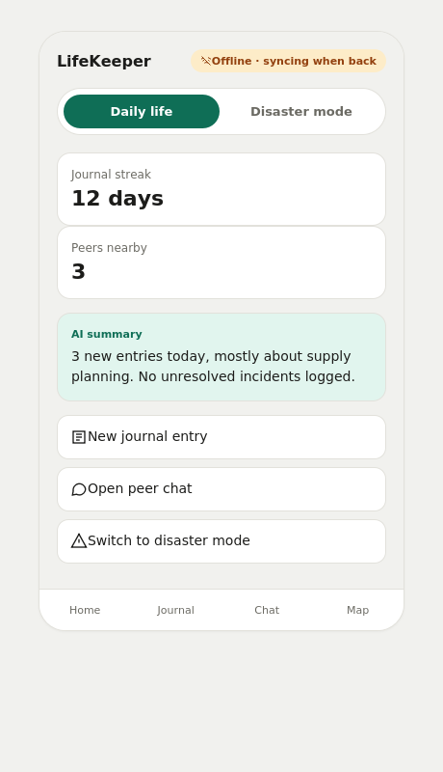
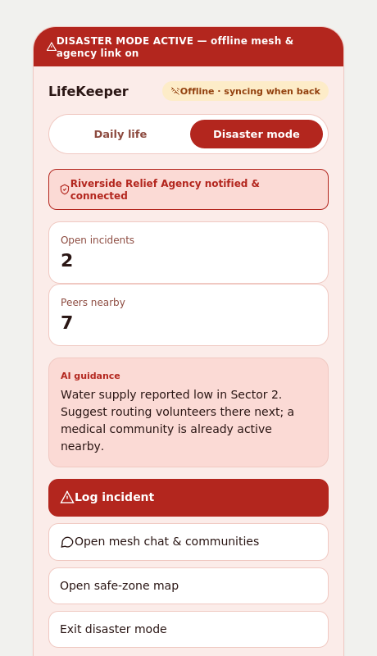
THE APP
DAILY VS. DISASTER ZONE
Same app. Two zones, colour-coded so you always know which one you're in.
DAILY ZONE
DISASTER ZONE
Mode toggle at the top of every
screen — the whole UI recolours
the instant you switch, so the
zone you're in is never in doubt.

Slide 9
TWO ENGINES, ONE DEVICE
COMPARISON
The same app. Two personalities. One slider
apart.
Daily mode spends power to give you a richer AI and full sync. Emergency mode spends the same hour differently — it saves power, conserves screen, and keeps the mesh radio alive while everything else goes dark.
MODE A
MODE B
HOUR 6 OF A BLACKOUT
Daily
Emergency
Same battery, very
different morning.
~100%
~40%
Daily
Reference power draw
Conservative draw
60% remaining
+ Full background sync on
+ Larger model, richer summaries
+ Notifications + reminders on
– Background sync paused
– Smaller model, tighter answers
+ Mesh radio held warm
Emer.
88% remaining
Same phone. Same disaster. +28% battery at the moment you need it most.
Best: power, signal, calm
Best: lost signal, lost hours, lost power

Slide 10
UNDER THE HOOD
RESILIENT SYNC
Layer 1
Layer 2
Layer 3
ARCHITECTURE
Local store
Local AI
Mesh layer
Offline
first.
Reconcile
after.
Every entry lives on-device first. Reads, writes, and search work without a server.
A small model summarises, classifies, and prompts. No round trip. No latency tax.
Phones become relays. Wi-Fi Direct + Bluetooth LE carry peer chat and logs.
Layer 4 · The Reconciler
Layer 5
CRDTs & vector clocks
Sync, when ready
When many devices edit offline and reconnect, conflicts resolve without losing anyone’s truth. Two nurses logging the same patient at once both survive.
Auto-sync once connectivity stabilises. Before/after allowed. Delta-only payloads.
TYPICAL LIFECYCLE OF A DISASTER LOG
A device is never down because the network is. The cloud is invited later; it is never the boss.
Capture → Merge → Summarise → Surface → Sync
Each arrow is local if it can be. Each step has a fallback. A 30-second capture still survives a 30-hour blackout.
TRUST THE ORDER
Local log → peer merge → eventual cloud sync.
EACH LAYER OPTIONAL. THE SYSTEM SURVIVES ANY SINGLE LAYER FAILING.

Slide 11
TRUST
PRIVACY & SECURITY
You hold the key. The phone holds the
weight.
E2E
End-to-End
A thought kept offline is not a thought owed to anyone. A disaster log kept on-device is not a log that can be subpoenaed across borders by accident.
Principle 1
Principle 2
Principle 3
Local-first encryption
Peer channels stay peer-only
A wipe you control
Every entry is encrypted on the device before it ever leaves. Personal logs and disaster logs live behind the same key, on the same hardware.
Mesh messages between phones are encrypted at the session layer. No provider sees them, even if every relay was hostile.
One tap erases the personal layer. One separate tap erases the disaster layer. One tap erases everything. You choose how thin your trail stays.
.

Slide 12
THE CALLBACK
SAME DISASTERS, DIFFERENT TOOLS
The same three disasters. A different tool in every pocket.
Illustrative, not a guarantee — no app can promise outcomes in a real disaster. But every failure on the earlier slide was a communications failure, and that is exactly the layer LifeKeeper targets.
NURDAĞI, TURKEY · FEB 2023
PARADISE, CALIFORNIA · NOV 2018
KERALA FLOODS, INDIA · 2018
THEN
THEN
THEN
“We could hear their voices…” — but overwhelmed cell networks slowed locating everyone in time.
"A single phone-based alert system reached under 30% of residents, then failed further as cell towers burned and lines jammed."
Telephone and mobile networks failed, making it “difficult to deal with requests for help and coordinate rescue efforts.”
WITH LIFEKEEPER
WITH LIFEKEEPER
WITH LIFEKEEPER
The inbuilt map helps the survivors get as close to safehouses as possible, thus making it easier for the rescue team.
They also get a sense of togetherness and get as much information as possible from the chat rooms, making it easier to think of a way out.
Evacuation alerts propagate phone-to-phone over mesh the instant one neighbor gets word — no dependence on a single vendor's system or a tower still standing.
This system is more efficient in relaying the information among the affected.The homeowners can also coordinate amongst themselves to manage food supply and other necessities.
Volunteers and NDRF teams share one synced offline incident log over mesh, instead of jammed helplines and scattered WhatsApp threads.
The logs also help survivors understand the situation better thus relieving them from some stress and making the situation more manageable, thus reducing the overall anxiety and fear
WE CAN'T RERUN 2023 OR 2018. WE CAN MAKE SURE THE NEXT ONE ISN'T DECIDED BY WHETHER A TOWER SURVIVED.

Slide 13
WHERE IT LANDS & WHO CARRIES IT
TEAM · IMPACT
Five people.
Five
places it has to matter.
THE TEAM
WHERE IT LANDS
Dhruv
Five places where resilience stops being
abstract.
BACKEND & SYNC ENGINEER
Peer-to-peer sync, CRDTs, log storage.
Prateek
01
Daily life · journaling, idea capture, offline productivity.
AI DEVELOPER
Offline AI for daily + disaster summarisation.
02
Disaster zones · relief workers coordinate without internet.
Taksheel
FRONTEND UI / UX DESIGNER
UX for journaling, chat, and dashboard.
03
Healthcare emergencies · offline patient triage and AI support.
Namit
CYBERSECURITY SPECIALIST
04
Community resilience · neighbours share info during blackouts.
Encryption, secure peer-to-peer comms.
Yuvraj
05
Critical infrastructure · outage logs synced locally first.
DEMO LEAD
Walks the demo path end-to-end.

